Slide 1
THE DIFFERENCES BETWEEN
GLOBAL TEAM
AND
OFFSHORE TEAM

Slide 2
Overview
What is Offshore team model?
What is Global team model?
Hearing result from current Global team member
Differences of Global team and Offshore team
4.1 In Process
4.2 Quality
4.3 Cost
4.4 Addition values

Slide 3

1) What is Offshore team model?
A team with local peoples. All members have the same characteristics such as languages, culture, thinking, lifestyle, etc. Each of local team has their own mission, vision and goals. They need a BSE to communicate with other sides.
Customer
Team’s Goal
ON- SITE TEAM
Bringing the best services to customers
PM
SE
SE
SE
Different goals
(Biggest issue)
OFFSHORE
TEAM
BSE
Developing program for on-site team
SE
SE
SE

Slide 4
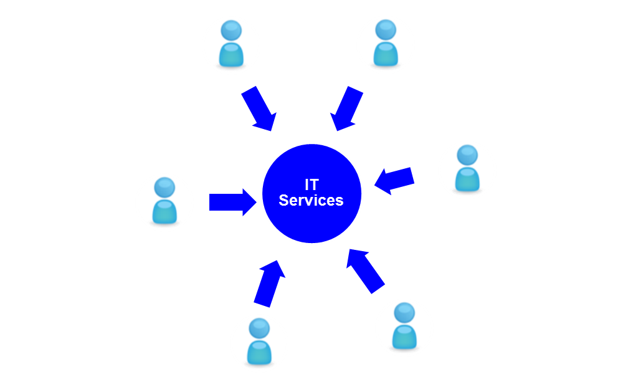
2) What is Global team model?
Team members come from many countries and territories. They might have distance in culture and language but they have same mission and vision to achieve their goals.
Points of global team
LDR
SE
Customers communicate with PM by local language. Then PM can use only English to communicate with other team members
Team members support each other directly
A global team doesn’t need to BSE because they have no more communication barriers.
Biggest issue is all team members have different culture what they have to solve
SE
Customer
PM
Local language communication
SE
LDR
English communication

Slide 5
3) Hearing result from current Global team member
Global team and offshore team have many differences. For examples: working environment, role of employees in IT process or communication between members, etc.
Offshore team
Global team
Competition
Work effectively with local environment
Have strength and ability to compete with just local business
Work effectively both in local and multiple environment
Competing with domestic companies and foreign companies
Mission and vision
Offshore team and on-site team have their own mission and vision
Same mission and vision to achieve their goals
Language
Communicating through BSE
Communicating by English

Slide 6


4) Differences of Global team and Offshore team
4.1 In process
Global team: All members have same mission and vision to achieve their goals in every project.
offshore team: Divided to small team. Each of local team have their own mission, vision and goals.
On-site
Requirements
Development
Basic Design
Integration
Test
System Test
System Release
Maintence System
Divided to small team
Offshore
Detail Design
Coding
Unit Test
Work together even business layer
On-site
Requirements
Development
Basic Design
Detail Design
Coding
Unit Test
Integration
Test
System Test
System Release
Maintence System
Offshore

Slide 7
4) Differences between Offshore team and Global team
4.2 Quality
The difference of two models are the advantage and disadvantage of each model. Global team model can bring to company some benefits, beside that Global team have difficulties also
Offshore team
Global team
Knowledge
Team members between two countries cannot share information to each other
In a team, members can share the knowledge, some new skills to help team members improve their abilities
X
O
Talent
Offshore team just do small project and exploit human resource in local
In global team, we can find and use new talent come from another countries, and global team can do multinational projects
X
O
Product quality
Offshore development product just suitable to local companies
Product of Global team can meet the needs of both foreign clients and local clients
X
O
Team work
X
Team member can work together, discuss directly, and support each other, avoid the argue between two members
Team work by chat voice or share screen, sometime team work is not effective, and spend a lot of time to discuss However, we want to overcome this issue with our experience.
O
Communication
Offshore team and On-site don’t communicate with each other, all the reference through BSE
O
X
Although have a barrier about language, but in global team, between team members have the connection and they usually communicate with each other

Slide 8
4) Differences between Offshore team and Global team
4.3 Cost
The difference of two models are the advantage and disadvantage of each model. Global team model can bring to company some benefits, beside that Global team have difficulties also
Offshore team
Global team
BSE Cost
Higher cost, because offshore team have to pay BSE fee. And in a Offshore team model needs a lot of BSE.
O Although global team have to pay fee for global training program but in the future their can save BSE fee
X
X
O
Productivity
Offshore team have to spend more time for BSE to translate, deliver information, and sometime cause the overload information.
Beside that, Offshore team can prevent from the discussion between team members because offshore team just take tasks and follow the requirement of On-site team. So that, offshore team can save time when do a project
Team members discuss and get task directly from team leader and save a lot of time
Global team requires team members have enough experiences and English skill.
In short term it’s a disadvantage, but in the long-term, when team members work together effectively, Our company can save time to do a project, and come up with new products faster than our competitor
X
O
Training cost
Offshore team don’t need to training team leader and pay for training language cost
Team leader have to join in a training program to lead, manage a Global team and learn English
O
X

Slide 9
4) Differences between Offshore team and Global team
4.4 Addition values
The difference of two models are the advantage and disadvantage of each model. Global team model can bring to company some benefits, beside that Global team have difficulties also
Offshore team
Global team
Market segmentation
Just focus on local business.
The company can develop their business to another countries, and their product can suitable for many different companies
X
O
Culture
The same culture help offshore team can work together easier, and just BSE know about the culture of two countries
(For example : Overtime culture)
The differences in culture can make some misunderstanding between two members
O
X
Manage
The team leader can mange team easy and review task of team member by daily report
X
Hard for team leader can mange a global team when make a decision or solve problem between two members, team leader have to know clearly his team to assign task.
O
All the seminar members of IBSV think that, they want to work in a global team, because they see the benefit that the global team can bring to them and our company. They believe, in the future, Global team will be used widely over the world

Slide 10
THANK YOU

